Slide 1
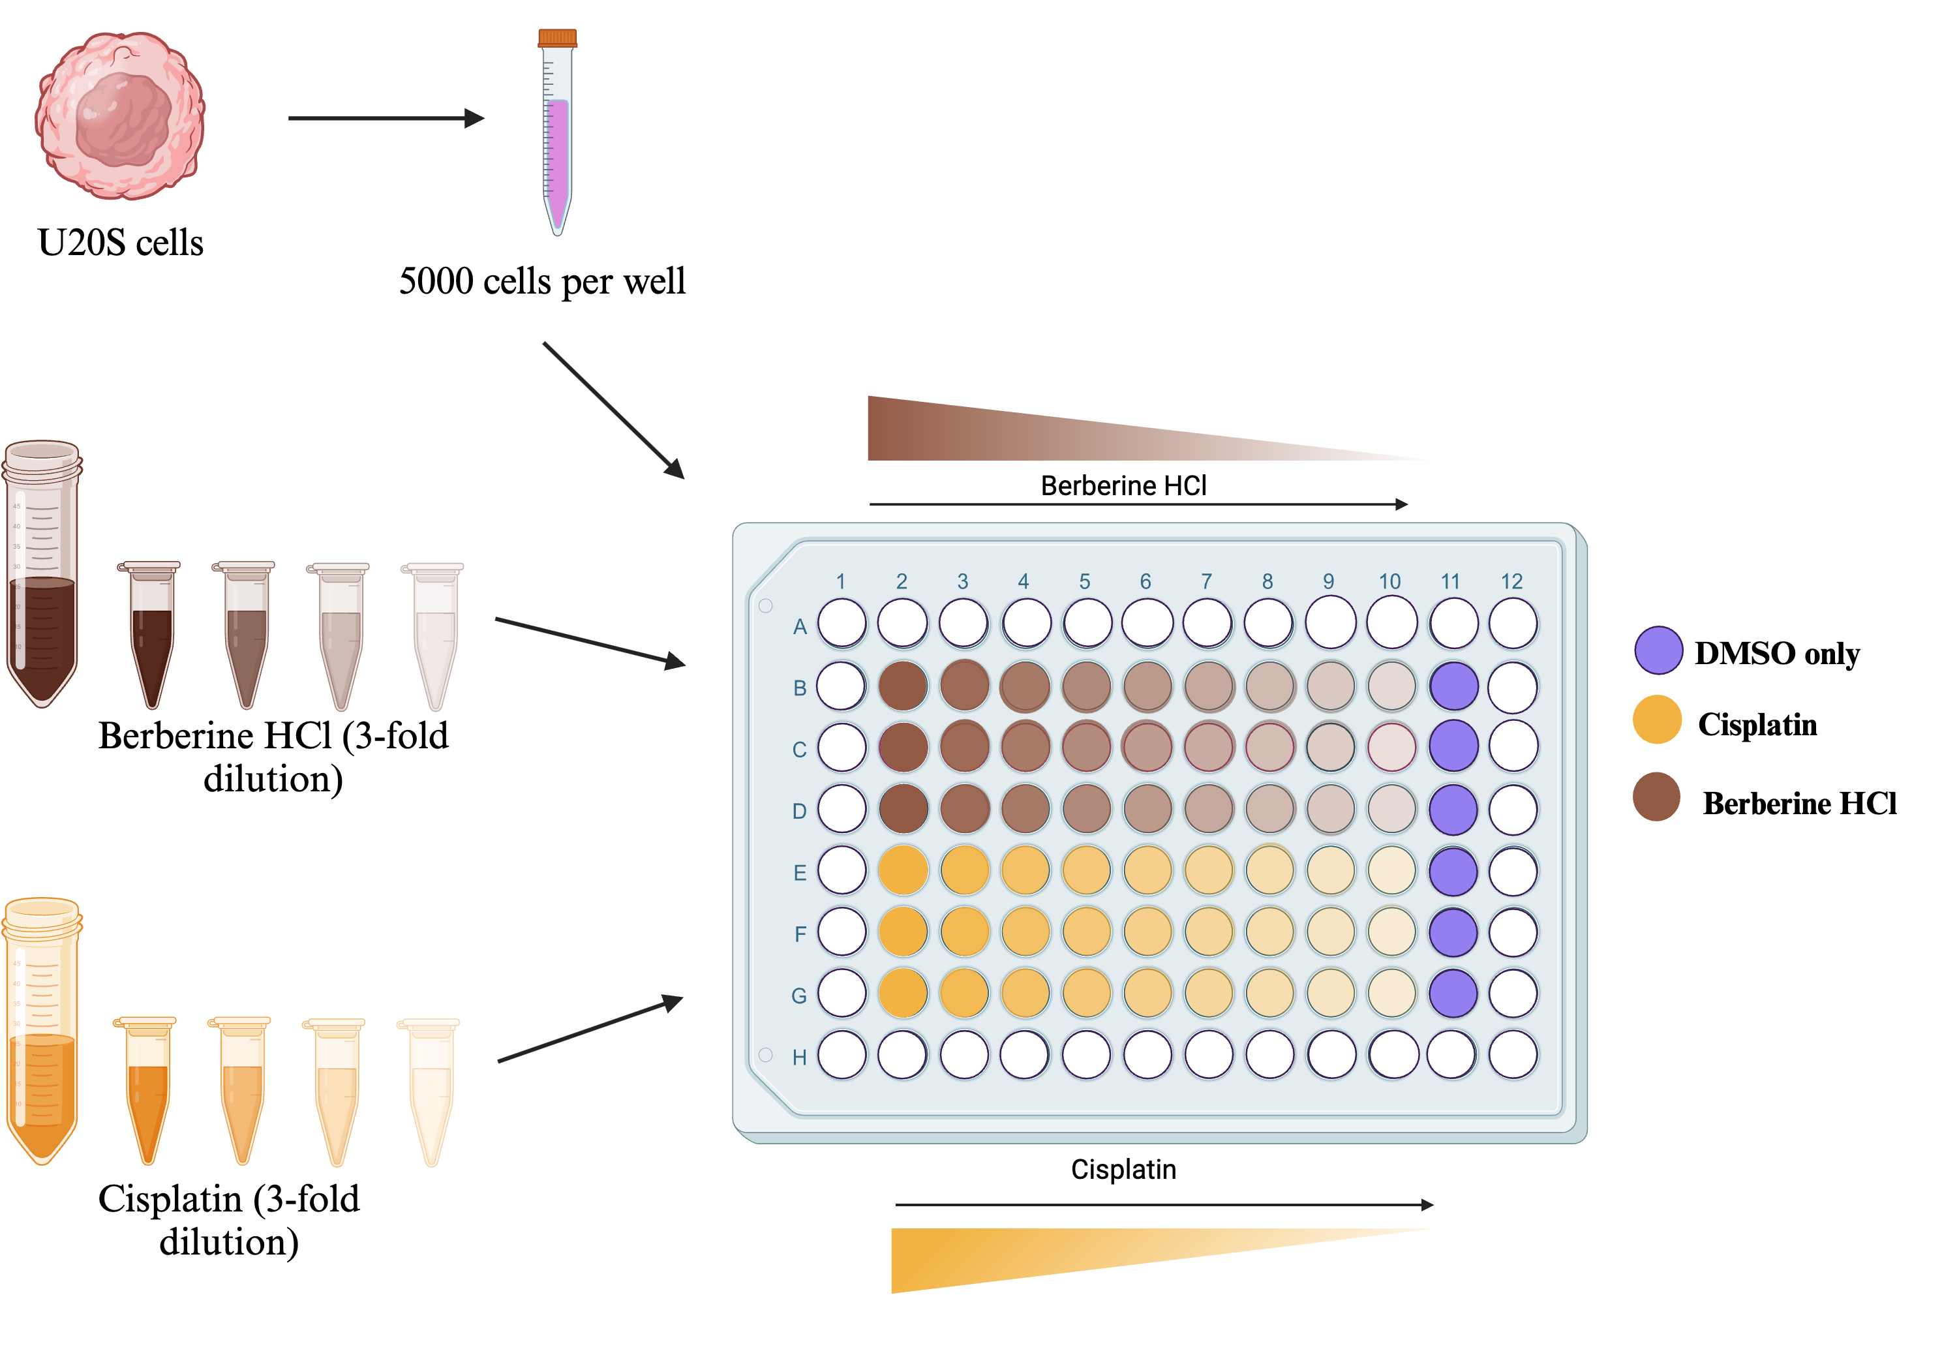
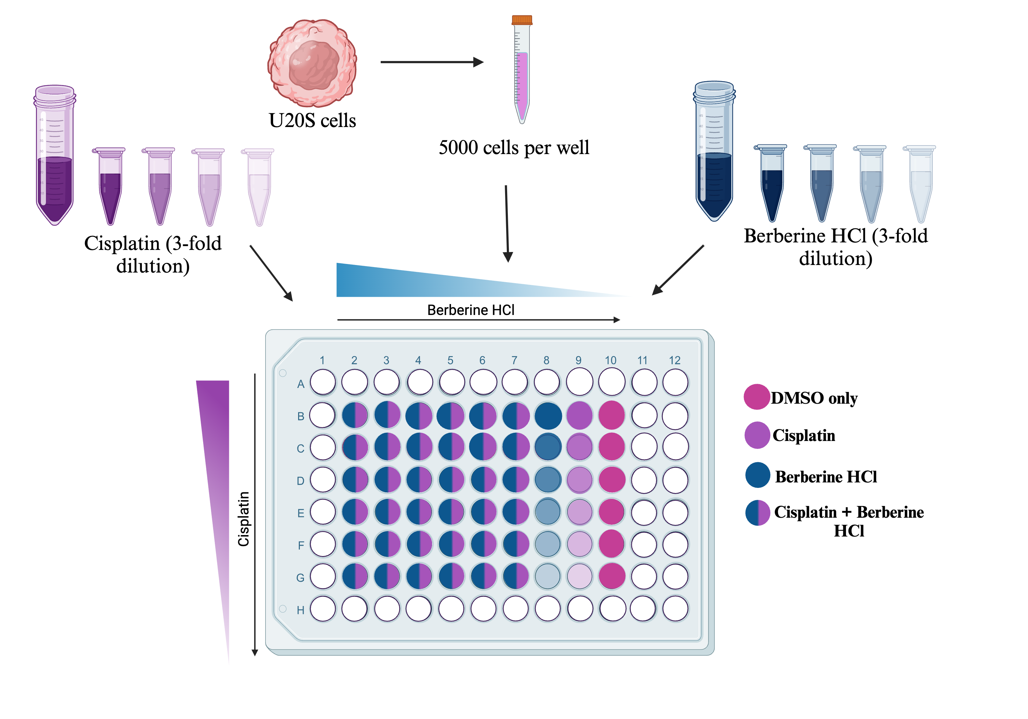
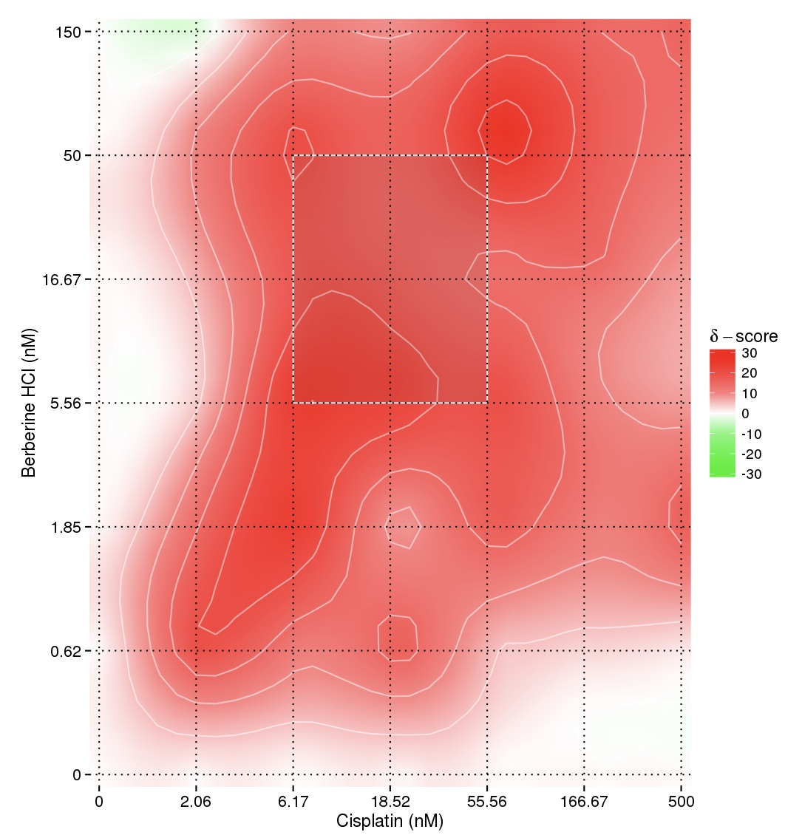
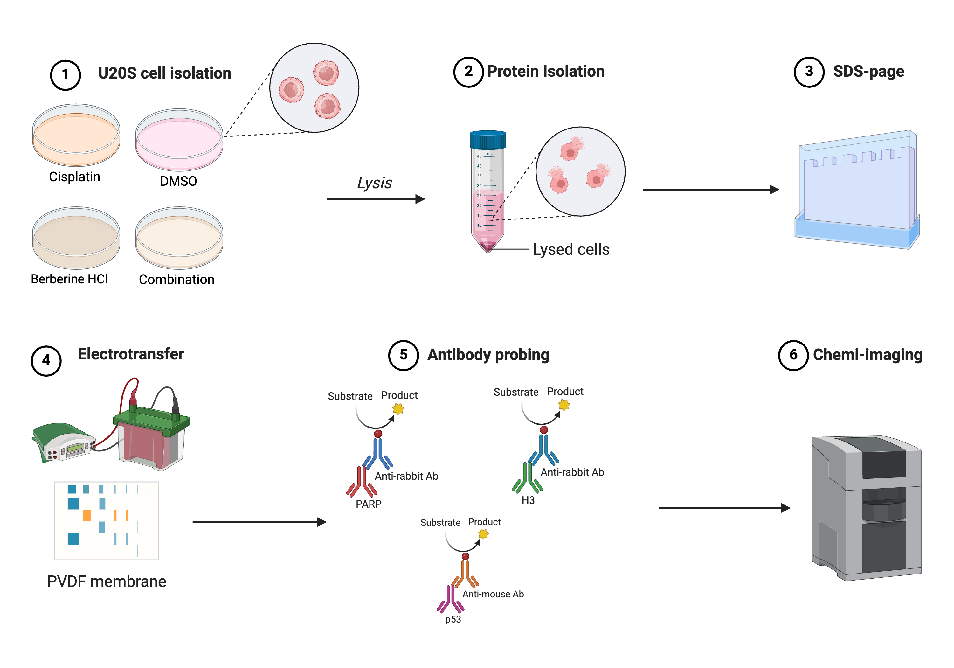
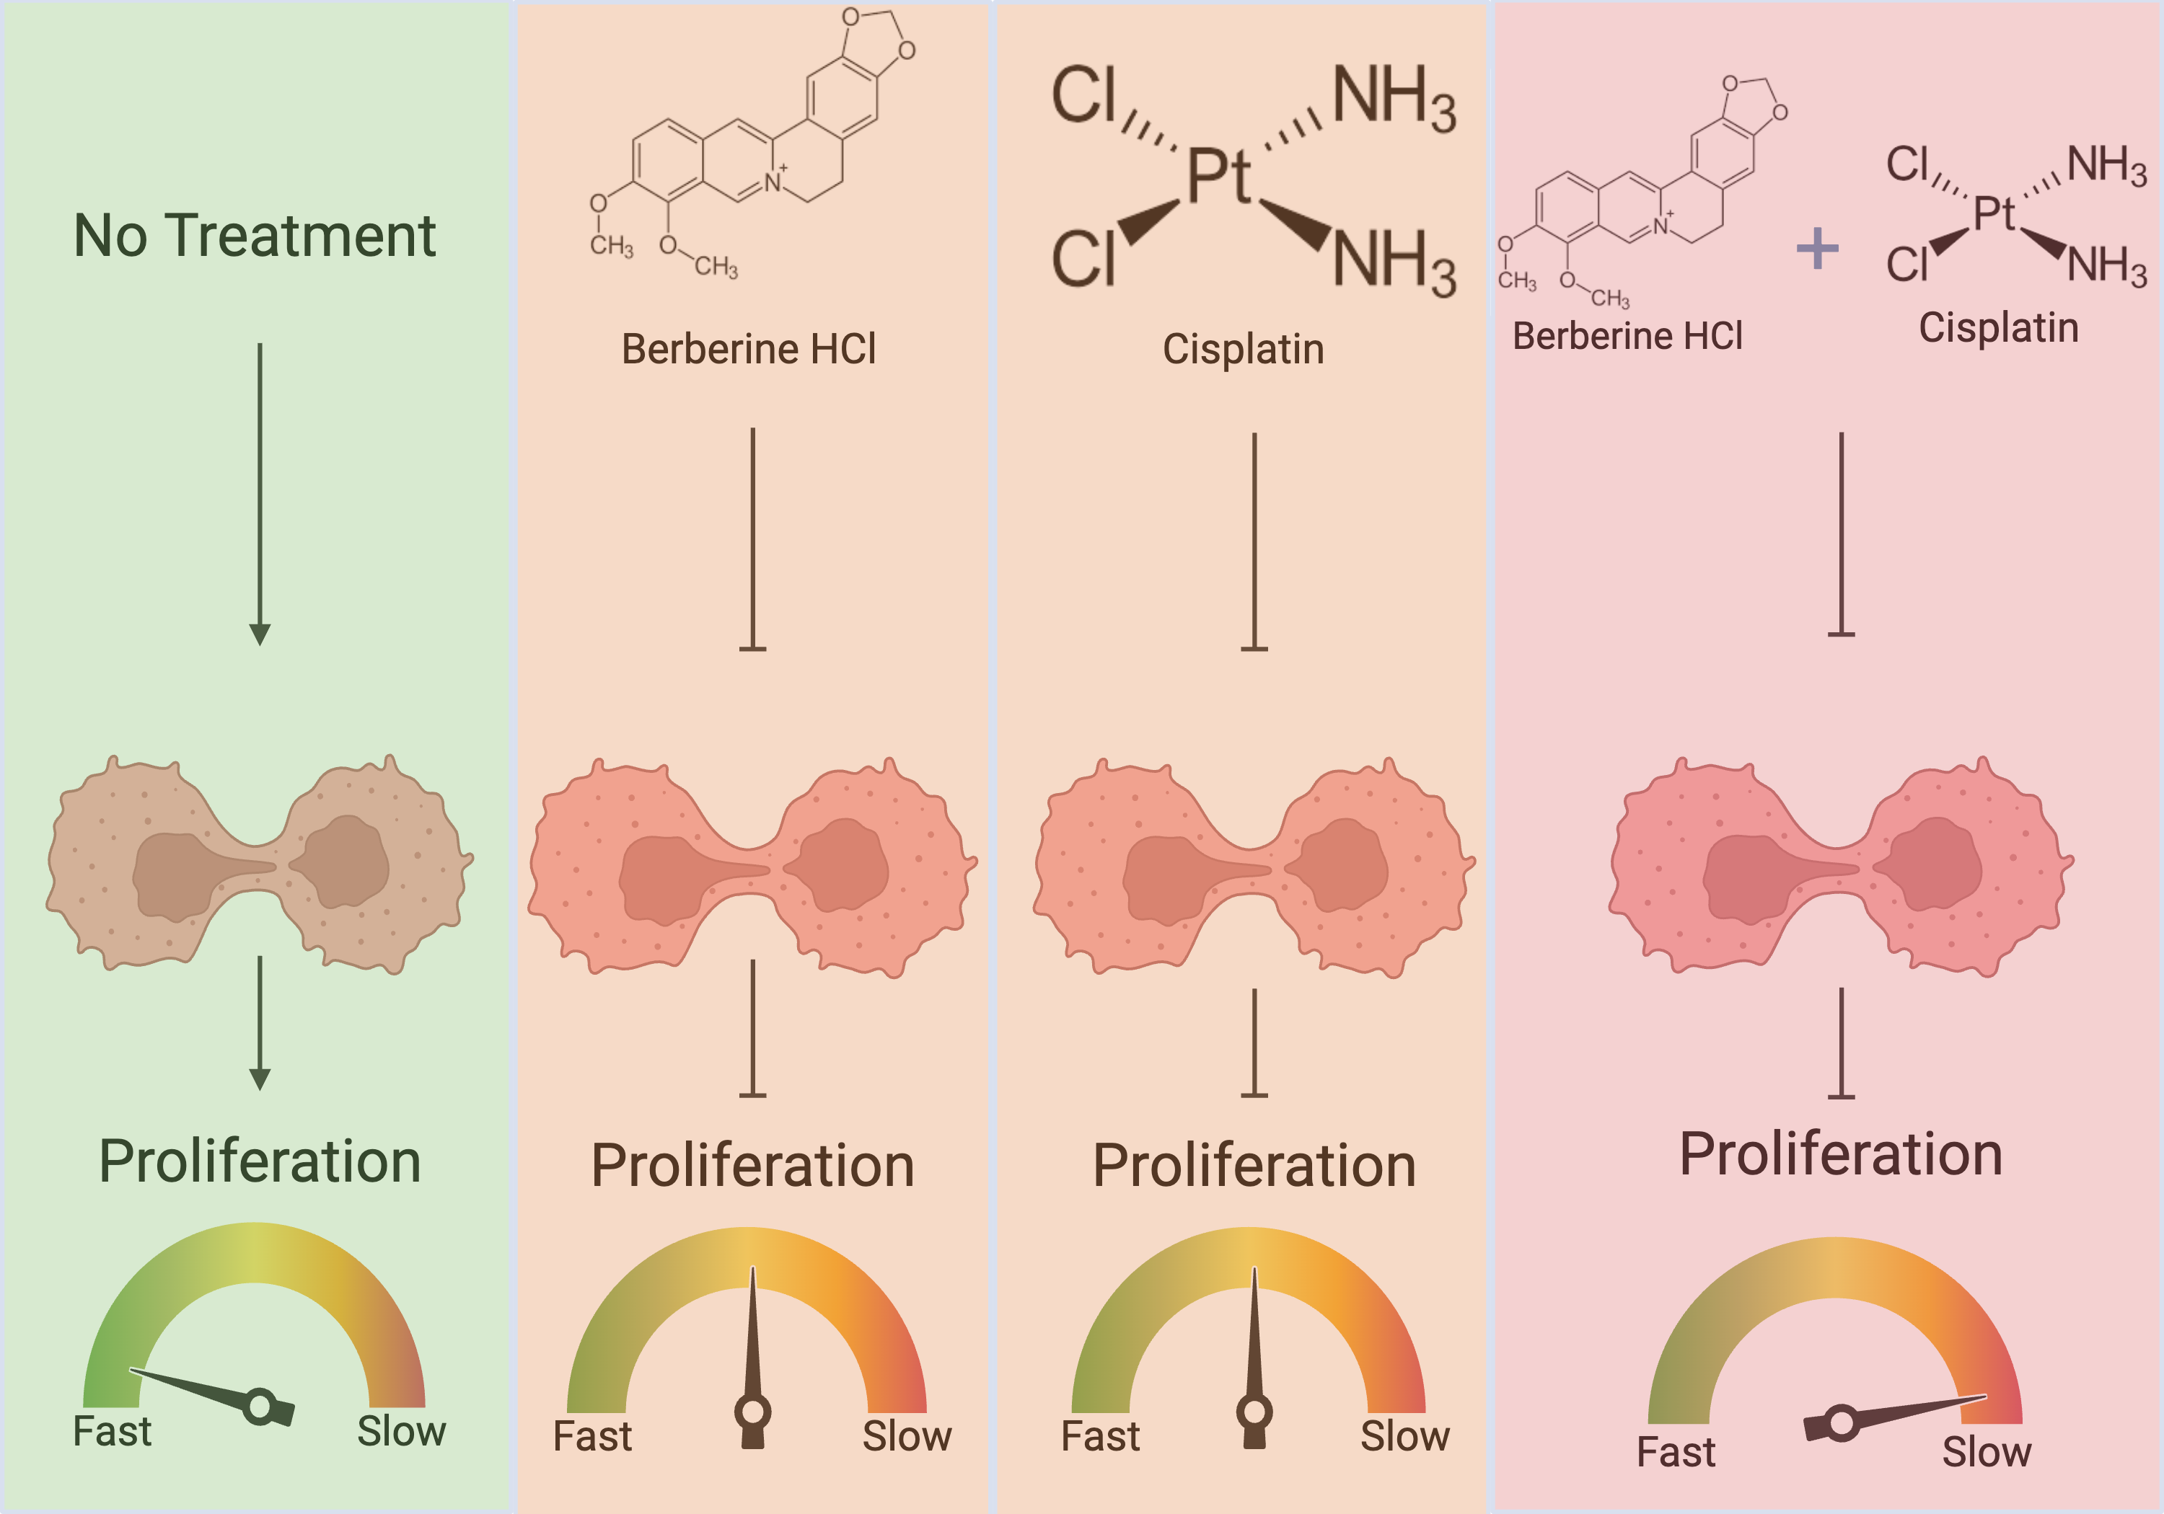
Enhancing Chemotherapy: Synergistic Action of Cisplatin and Berberine Hydrochloride Against Osteosarcoma
Adam Al-Droubi, Andrea Florian, PhD
Biology Department, Belmont University, Nashville TN
Abstract
Methods
Results, continued
Osteosarcoma, the most common type of bone cancer, is notably aggressive and prone to a rapid rate of metastasis. When the tumor is localized; the survival rate is approximately 76% and can often be treated with surgery. However, once metastasis occurs, the survival rate drops to 24% and must be treated with chemotherapy. The standard treatment for metastatic osteosarcoma typically involves combination therapeutics, with cisplatin being a key component despite its severe side effects. Unfortunately, osteosarcoma exhibits a natural resistance to chemotherapy driven by the overexpression of drug efflux pumps, DNA repair mechanisms, and apoptosis avoidance mutations. To address these limitations, our study explores the efficacy of combining cisplatin with berberine HCl, an isoquinoline alkaloid salt extracted from Berberis aristata bark. Berberine HCl, an over-the-counter supplement has demonstrated potential in inducing apoptosis and inhibit cancer cell proliferation by promoting the release of cytochrome c in the mitochondria, downregulation of both cyclins and Bcl-2 protein family. We hypothesized that the distinct mechanistic actions of cisplatin and berberine HCl would yield synergistic effects on cell death. Our findings confirmed that the combination of these agents significantly decreases cell viability and increases apoptosis in osteosarcoma cells compared to either agent alone.
Figure 7. Synergy Graph. This graph depicts the synergistic effects at different concentrations of cisplatin and berberine HCl. The red color indicates synergistic effects, and the green represents antagonistic effects.
Introduction
Figure 2. Single Agent Dose Response. This schematic illustrates the methodology of a dilution assay of cisplatin and berberine HCl. The goal of this assay is to determine the range of concentrations of each compound to use for the synergy assay.
Figure 3. Synergy Assay. This schematic illustrates the methodology of a synergy assay between cisplatin and berberine HCl. U20S cells are treated with various concentrations of each compound both individually and combined to be able to determine synergistic effects.
Osteosarcoma is an aggressive bone cancer that results in a poor prognosis in patients due to its rapid metastasis. ¹Approximately 1,000 new cases of osteosarcoma are diagnosed annually, with about half in children or adolescents. The poor prognosis associated with osteosarcoma is largely due to its high rate of metastasis. ¹The 5-year survival rate is around 76% before metastasis but drops to 24% once the cancer spreads. ⁴Osteosarcoma commonly originates in larger bones, such as the femur, and spreads through the bloodstream. ⁴At the time of diagnosis, 15-20% of patients already have metastases, and 30-40% will develop metastases after diagnosis. ¹Surgery is the most effective treatment for localized osteosarcoma, while metastatic cases rely on chemotherapy, particularly cisplatin, despite its severe side effects.
²Osteosarcoma’s natural resistance to chemotherapy is due to overexpression of drug efflux pumps, which eject chemotherapy drugs from the cancer cells, allowing them to survive and proliferate. Given the high rates of metastasis and poor survival outcomes, it is evident that the current treatment options are inadequate and require an improvement. I propose to combine Berberine HCl to improve treatment efficacy while potentially reducing the side effects associated with chemotherapy. Berberine HCl is a salt form of an isoquinoline alkaloid extracted from Berberis aristata bark. It is available as an over-the-counter supplement and is considered safe for human consumption. The public commonly uses berberine HCl as a glucose disposal agent to help reduce blood sugar levels. ³Berberine HCl has been shown to induce apoptosis and inhibit cancer cell proliferation by promoting the release of cytochrome c in the mitochondria, downregulation of both cyclins and Bcl-2 protein family. I hypothesize that the combination of cisplatin and berberine HCl will be more effective in killing osteosarcoma cells and inducing apoptosis than either agent alone. To test this hypothesis, I will perform synergy assays to determine if berberine HCl and cisplatin have synergistic effects and use western blot to visualize U20S cell viability after drug treatment.
Berberine HCl
Cisplatin
Combination
DMSO
Figure 8. Western Blot. Western blot performed on lysates from U20S cell lines that were treated with DMSO, 20μM cisplatin, 10 μM berberine HCl, or combination of 20μM cisplatin + 10 μM of berberine HCl.
PARP
Figure 4. Western Blotting. This schematic displays the methodology of a western blot.
p53
H3
Conclusions/Future Directions
The goal of this study was to investigate whether berberine HCl and cisplatin exhibit synergistic effects on U20S osteosarcoma cells. Our findings reveal the presence of these synergistic effects. We would like to repeat these experiments to gather a larger sample size of data. In the future, we plan to test berberine HCl on various other cancer cells lines, as well as testing with other chemotherapies to assess whether berberine HCl shows the same synergistic effects. Future studies in a clinical study assessing the reduction of side effects from chemotherapies using Berberine HCl would also be beneficial.
Results
Figure 1. Synergistic Action of Treatments. This schematic illustrates the synergistic actions of berberine HCl and cisplatin in U20S cells.
References & Acknowledgements
Osteosarcoma. Johns Hopkins Medicine. (2024, May 15).
Garcia-Ortega, D. Y., Cabrera-Nieto, S. A., Caro-Sánchez, H. S., & Cruz-Ramos, M. (2022, June 23). An overview of resistance to chemotherapy in osteosarcoma and future perspectives. Cancer Drug Resistance.
Zhu, Y., Xie, N., Chai, Y., Nie, Y., Liu, K., Liu, Y., Yang, Y., Su, J., & Zhang, C. (2022, January 10). Apoptosis induction, a sharp edge of berberine to exert anti-cancer effects, focus on breast, lung, and liver cancer. Frontiers.
Osteosarcoma: Osteosarcoma information. Osteosarcoma Information | American Cancer Society. (n.d.).
Chen ZZ. Berberine Induced Apoptosis of Human Osteosarcoma Cells by Inhibiting Phosphoinositide 3 Kinase/Protein Kinase B (PI3K/Akt) Signal Pathway Activation. Iran J Public Health. 2016 May;45(5):578-85. PMID: 27398330; PMCID: PMC4935701.
Ortiz LM, Lombardi P, Tillhon M, Scovassi AI. Berberine, an epiphany against cancer. Molecules. 2014 Aug 15;19(8):12349-67. doi: 10.3390/molecules190812349. PMID: 25153862; PMCID: PMC6271598.
Jin H, Jin X, Cao B, Wang W. Berberine affects osteosarcoma via downregulating the caspase-1/IL-1β signaling axis. Oncol Rep. 2017 Feb;37(2):729-736. doi: 10.3892/or.2016.5327. Epub 2016 Dec 16. PMID: 28000894; PMCID: PMC5355653.
Wang J, Yang S, Cai X, Dong J, Chen Z, Wang R, Zhang S, Cao H, Lu D, Jin T, Nie Y, Hao J, Fan D. Berberine inhibits EGFR signaling and enhances the antitumor effects of EGFR inhibitors in gastric cancer. Oncotarget. 2016 Nov 15;7(46):76076-76086. doi: 10.18632/oncotarget.12589. PMID: 27738318; PMCID: PMC5342797.
Schematics were made using BioRender and synergy data was derived using SynergyFinder.
Figure 5. Cell %Viability of Cisplatin. This graph displays the percent viability of U20S cells caused by cisplatin at different concentrations.
Figure 6. Cell %Viability of Berberine HCl. This graph displays the percent viability of U20S cells caused by berberine HCl at different concentrations.

