Slide 1
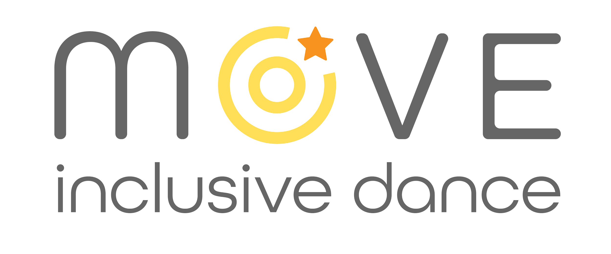
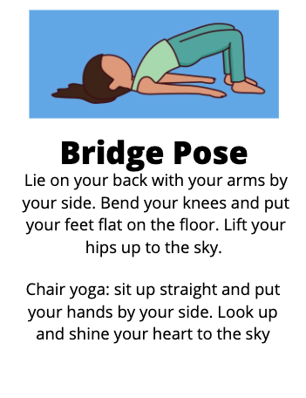
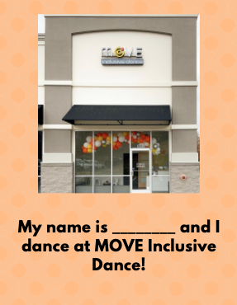
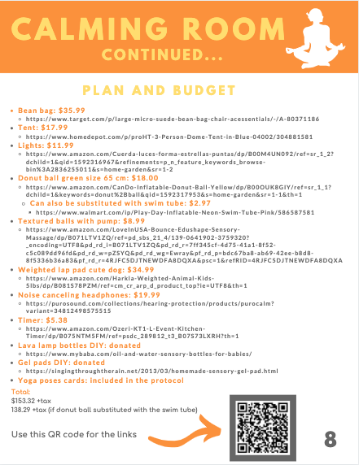
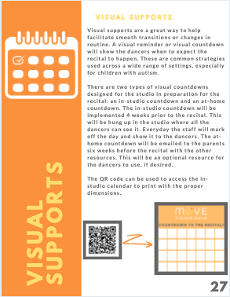
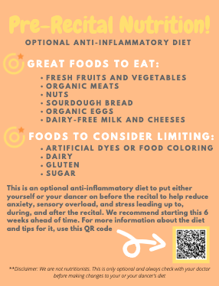
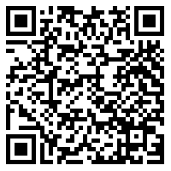
Self Regulation Protocol
for Move Inclusive Dance
Rebecca Denton, OTS
Move Inclusive Dance
Outcomes
Goals
Mission:
We use the power of movement and music to transform the lives of our students. Our program is available to individuals of all ages and ability levels, making an inclusive environment for our students to learn life skills and experience social development together.
Vision:
Move Inclusive Dance will be a leading organization for families of loved ones with special needs. Through our programming, we will continue to create a sense of inclusivity and positivity that transcends beyond our walls. Our students will leave our classes better humans, therefore making the world a better place.
The self-regulation protocol was made into a training manual. The protocol and manual contain instructions, guidelines, and the evidence behind the sections included. These sections are: yoga, social narrative, sensory room, visual countdown, and optional nutrition guide.
Learning Objectives:
Student will seek out guidance and mentorship from professionals within and outside of the field of occupational therapy in regards to the sensory space.
Student will build understanding of the student/population by spending time immersed in the population at the Move Inclusive Dance studio and observing dance classes, whether in person or virtual.
Student will research best practices for facilitating the transition from studio to recital and will present them to the staff.
Student will create an evidence-based sensory space plan and transitioning program to facilitate the transition from studio to recital.
Student will train the staff on the sensory space and transitioning program and evidence-based practices.
Personal Objectives:
Student will gain the skill of program development by creating a self-regulation program.
Student will create a training manual to disseminate information about the self-regulation program.
Yoga
Social Narrative
Needs of the Agency
This self-regulation protocol was developed to assist the staff at Move Inclusive Dance with the transition from studio to recital hall, while caring for the sensory needs of all the dancers. Move Inclusive Dance serves individuals with many different types of disabilities and needs. Some of the students are typically developing, while others may have physical, cognitive, or sensory-based limitations. Sensory processing disorder (SPD) is a common disorder, with 5% of the general population experiencing it (Miller et al., 2014, pp. 249-250). It is even more popular in individuals with autism and/or Down Syndrome, which is the MID population’s most common diagnoses. The frequency of SPD is around 90% in autism and about 49% in people with Down Syndrome (Bruni et al., 2010; Deweerdt, 2018). From last year’s enrollment, 43.9% of the students had either Down Syndrome, autism, or SPD. People with autism and SPD favor consistency and predictability. Change of routines and transitioning to new places can create stress, anxiety, and potential behavior problems (Glass, 2017; Hume, 2008).
Sensory Room
Visual Countdowns
Acknowledgments
Nutrition Guide
QR Code to Access the Training Manual
Special thanks to my faculty mentor, Dr. Lemmonds. She was an incredible resource for me while creating this protocol. My expert mentor, Lauren Beasley, provided amazing guidance and support the whole time. I am thankful for Dr. Iliff always being there to answer my questions. I also want to thank my parents for loving and supporting me through my experiential component and OT school in general.
References Available Upon Request

