Slide 1
the ONEAL project Negotiation Education for Library Workers
Tenn-Share eResources Fusion Friday
July 12, 2024

Slide 2
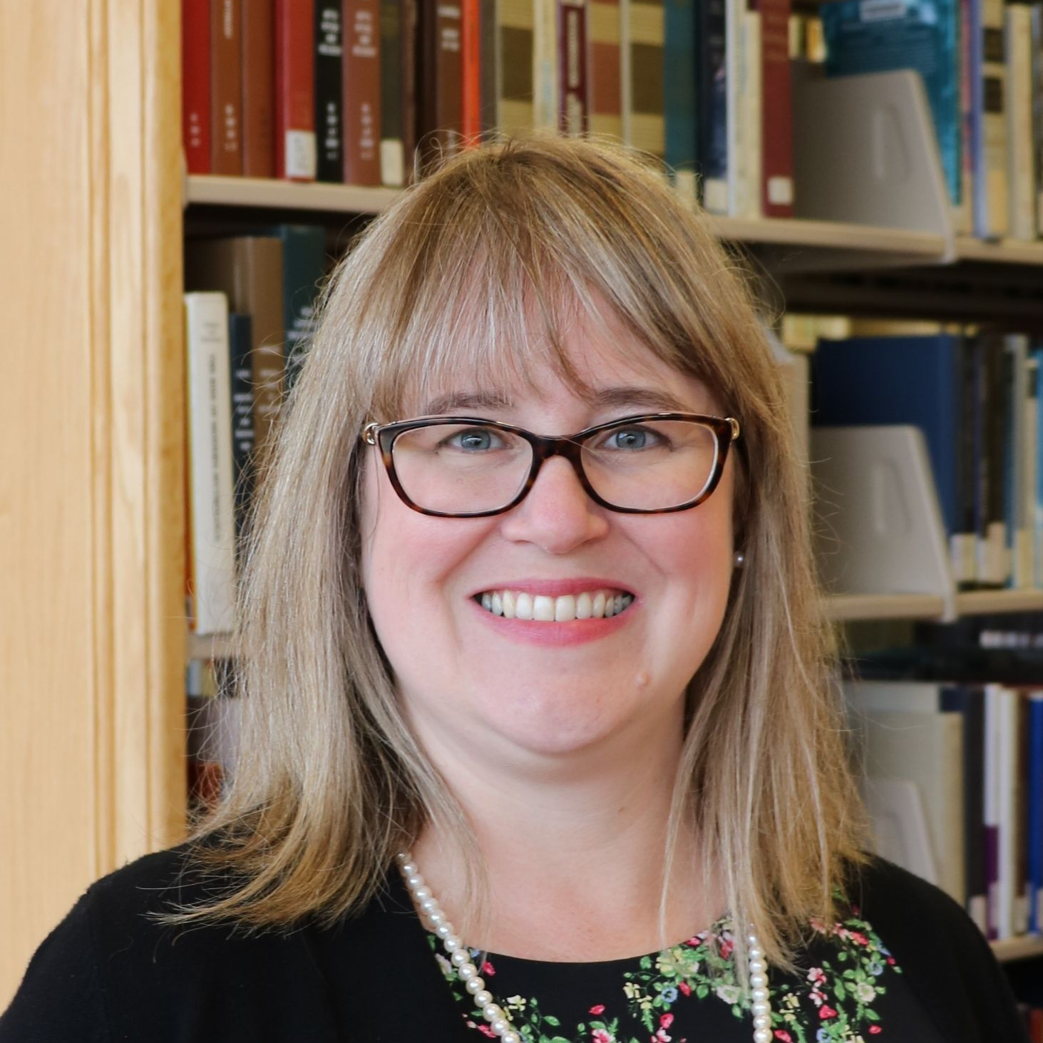
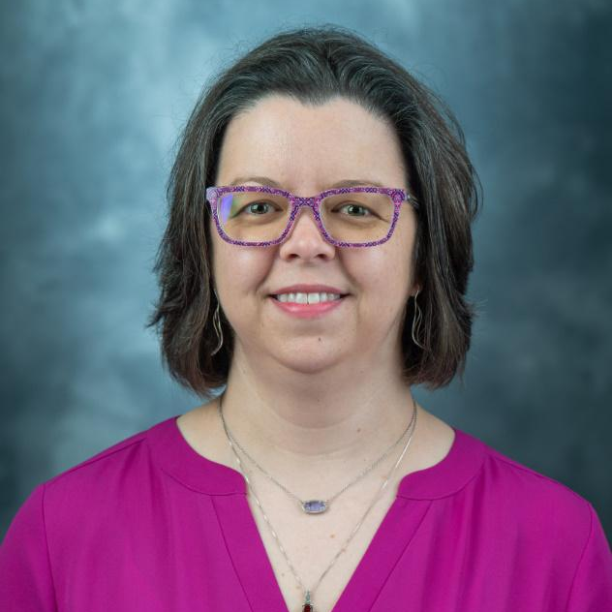
Project Team
Katharine V. Macy
Founding Director, Principal Investigator
Indiana University – Indianapolis (IUPUI)
Scarlet Galvan
Co-Principal Investigator
Grand Valley State University
Courtney Fuson
Co-Principal Investigator
Belmont University
Notes:
Brandy Roldan also served as our project assistant at the start of the project. We also have an advisory board made up of 7 people from a variety of libraries and library-adjacent organizations.
Advisory Board:
Brandon Butler, Director of Information Policy at University of Virginia. He brings expertise in vendor negotiation, licensing, and policy issues with collections at both the university and consortia levels (VIVA).
Galadriel Chilton, Director of Collections Initiatives at Ivy Plus Libraries Confederation. She brings 20 years of experience in e-resource negotiations both at institutional and consortia levels. She is also a former lecturer on e-resource management at the School of Library and Information Science at University of Wisconsin-Madison and the editor and author–with 10 past and present e-resource managers–of Managing Licensed E-Resources: Techniques, Tips, and Practical Advice, an open access e-book published by Pacific University Press.
Gregory Eow, President at the Center for Research Libraries, an international consortium of university, college, and independent research libraries. Prior to joining CRL he was the Associate Director of Collections at MIT Libraries.
Maya Hobscheid, Instructional Design Librarian at Grand Valley State University. She brings over 6 years of experience in instructional design within libraries. Currently she provides pedagogical leadership and ongoing support for online, hybrid, and in-person library instruction at GVSU.
Christine Morris, Digital Resources Manager at OPLIN (Ohio Public Library Information Network). Prior to joining OPLIN in 2021, she was the deputy director of OHIONet, a consortium that negotiated resources that served academic, public, government, and special libraries.
Nick Shockey, Director of Programs & Engagement at Scholarly Publishing & Academic Resource Coalition (SPARC). He is responsible for growing SPARC’s engagement with members and the wider community, managing SPARC’s digital platforms, and developing initiatives across SPARC’s program areas.
Helene Williams, Teaching professor at University of Washington. In her role at University of Washington she teaches classes on academic librarianship, digital humanities, and collection development and is an active member of the MLIS program committee. Her experience includes reference and instruction librarianship, and work as a humanities bibliographer at Harvard University.

Slide 3
Agenda
What is the ONEAL Project?
Drafting the Curriculum
Launching the Curriculum
The Curriculum!
Next Steps

Slide 4
What is the ONEAL project?

Slide 5
the ONEAL project
ONEAL = Open Negotiation Education for Academic Libraries
An IMLS funded project to teach negotiation skills to academic library workers who work with vendors via an OER with lesson plans, readings, lectures, case studies, and hands-on assignments to support both individual and group learners.
Notes:
Open Negotiation Education for Academic Libraries aka the ONEAL project is a collaboration between Indiana University – Indianapolis (formerly IUPUI), Grand Valley State University, and Belmont University. We are developing an open educational resource (OER) in support of continued development of negotiation skills in academic libraries and graduate library science programs. This OER will use the academic library context to teach negotiation theory and strategy and is built on real-world scenarios from the community. It will have a synchronous learning modules with synchronous teaching support materials to help group learning. Case studies based on real experiences in academic libraries will enable learners to put new concepts into practice.

Slide 6
Why?
To build a more sustainable future for libraries.
Professional development should be available for everyone.
We can and should negotiate.
Notes:
More and more library jobs are asking for skills in negotiation, resource management strategies, and understanding how licensing terms impact research, teaching, and learning. However, our exposure to developing these skills often happens on the job. There are formalized programs around, but they can be very expensive. There are also trainings that may be available at conferences (like this one!), but that also requires resources and is very difficult to scale. ONEAL is attempting to solve the scalability problem. We want to make negotiation training available to all organizations, no matter what resources are available. We want to make this training available to any library worker who is interested in learning these skills. Developing negotiation skills benefits all types of library workers. We focused on academic libraries because we needed a narrow focus for the first grant. A significant portion of this content will be useful for all library types and can even be useful in our personal lives! The skills learned from this OER can help you negotiate starting salaries, relocation allowance, start dates, mortgages, car purchases, and more! Some of the people involved in the initial stages of the project have also pointed out how similar this skill set is to organizing your workplace.
As we are aware, many of our institutions are dealing with slow growing, flat, or possibly declining budgets. Electronic resources prices remained mostly stagnant during the height of COVID-19, but many vendors are now trying to make up for growth lost during that time. This is after decades of vendors averaging a 6% annual price increase, while library budgets have not kept up. Libraries can and must negotiate to become sustainable. Even small, incremental changes at individual institutions can create the ripple that is the start of a tsunami. Places like University of California and University of Saskatchewan didn’t achieve their cancellations overnight – it was incremental work.

Slide 7
Drafting the Curriculum

Slide 8
Project Activities
Sept - Oct 2022
November 2022
Jan – Jul 2023
April 2023
Aug – Dec 2023
Jan – Mar 2024
Community Forums
Curriculum Planning Workshop
Curriculum Building
Interviews Conducted
Pilot Testing
Revision & Launch
Notes:
The project kicked off with three community forums held virtually in September and October of 2022. Each forum had a different focus – negotiation strategies and tactics; negotiating license terms; and current issues in academic libraries. Forum participants came from a wide variety of academic libraries and consortia. We had very lively discussions that provided right information for us to use in the curriculum development phase.
After the forums, our project assistant Brandy Roldan transcribed information from the jamboard, padlets, and forum chats so that we could then analyze it for themes, categories, and topics to use in building the curriculum.
Some of the themes that came out of those forums are:
Lag between tech and policy
Values alignment
How to prioritize action?
Challenges at all levels of experience, budget, role
Need for sustained community space with norms
Making our labor visible
Vanguards needed
In November 2022, we held a curriculum planning workshop with the project advisory board and 12 academic librarians who were active in negotiating for resources at their institutions. The curriculum planning workshop provided us with the structure and outline for the curriculum, as well as the learning objectives.
In January 2023, we started drafting the actual curriculum. During the curriculum drafting period, we also conducted interviews with librarians who work in negotiations. These interviews have been analyzed for key themes and will be used to create negotiation case studies for the curriculum.
After the curriculum was mostly drafted, we recruited pilot testers to review the drafted content and provide us with feedback. We requested their feedback on the content, structure, and pacing of the curriculum and made revisions based on this feedback. In March 2024, the curriculum was launched with the complete Foundations module and the Accessibility lesson of the Issues module.
For the rest of 2024, we will be extending outreach, offering to speak at groups to introduce the curriculum more widely. We are also continuing to draft lessons and new case studies.

Slide 9
93 attendees
20 library workers
35 interviewees
Average Community Forum attendance
Participants in Curriculum Planning Workshop
Qualitative Research Study
26 pilot testers
Completed the Foundations Curriculum
Notes:
Nothing for the community without the community. All these participants were also compensated for their time. We intentionally wrote compensation for the labor of volunteers into the budget for the grant, and we have been very intentional about soliciting participants for the forums, curriculum planning workshops, and interviews from underrepresented groups and those who work with under-resourced institutions.
DEI Statement:
The ONEAL project includes structural support to both invite and sustain participation from underrepresented library professionals. Our goal to produce open educational resources centered on negotiation practice and strategy will support the development of a critical skill set for managing collections and leading libraries. In each phase of the project, we will consciously invite and include librarians from underrepresented groups, particularly librarians of color and those who work with under-resourced institutions. This is particularly important in the planning and piloting stages of the project. When we solicit volunteers, we will ask that people complete a survey providing information about their interest, as well as the option to disclose demographics and institutional data so that we may ensure representation in attendance at the curriculum workshop, case study interviews, or participating in the pilot study.
We recognize people of color, particularly women of color, are often asked to provide their labor without compensation as part of service opportunities. To address this barrier to participation, a significant portion of the budget for this grant is earmarked to compensate those who participate as an advisory board member, in the 6-hour curriculum planning workshop, in OER content creation, and as pilot-testers. As part of content creation, ONEAL will cite and elevate the work of underrepresented experts and practitioners.
We will prioritize conferences and communication platforms for marginalized communities during our outreach.

Slide 10
Drafting the Curriculum
Three overarching modules – foundations, strategies, and issues
Each module has specific learning goals
Modules have specific topics/lessons
Notes:
As I mentioned previously, we used the information gathered from the forums to draft the curriculum. Based on insights gathered from the forums, we drafted the curriculum. We then worked with the participants in the curriculum planning workshop to identify learning objectives and shape the curriculum.
We mapped out three broad areas to be the overarching modules for the curriculum. Those areas are Foundations, Strategies, and Issues .Each of these modules will have a varying number of topics in them. This curriculum is designed to work either as an independent training (done by an individual) or as part of a course (either in a library school or offered by another group such as a consortium).

Slide 11
Modules
Foundations
Strategies
Issues
Contracts & licensing
intro to negotiations
planning for negotiations
Setting priorities
managing vendor relationships
power dynamics
project management
Current and emerging issues:
access models
transformative agreements
text data mining
privacy
authentication
accessibility
Notes:
The Foundations module will include the introductory materials such as the glossary, the historical context of library negotiations, an overview of the course, and the topics seen here.
The Strategies module is focused on providing structure for negotiations.
The final module we’ve drafted is the Issues module. This module is the one that should change more than any of the others going forward. We’ve tried to account for current issues and newer issues, but of course we can’t see the future to predict what might need to be addressed going forward. Because this will be an OER, the community will be able to step in and provide resources and information about the latest issues.
Foundations
Contracts & licensing will introduce participants to the anatomy of a license, how to navigate the contract review process, learning about and understanding their local context, and negotiating sticky terms. Understanding local context will help participants to determine who is involved in the decisions and processes locally and provide a chance to document that information.
Intro to Negotiations will look at business relationships between vendors and buyers (and how that differs from other types of relationships); principled negotiations; and how to empower yourself to negotiate and ask for what your library wants and needs.
The last topic in the foundations module will focus on Negotiation Planning – understanding your BATNA (Best Alternative to a Negotiated Agreement), determining your ZOPA (Zone of Possible Agreement), how to research vendors, preparing for no, and more.
Strategies
Providing structure for negotiations includes Setting Priorities - Using Pareto Analysis (the 80/20 rule) when you can’t negotiate every deal; basing your priorities on your library’s values (and how to live in the gap between your values and the actions of your library), and how to create value in the deal
This module will also help participants manage engagement before and during negotiations – this includes whether a negotiation should be a solo or team effort, how to engage with other librarians, administration, faculty, students, the procurement office, and general counsel at your institution. Engagement is also where we’ll talk about consortia and other relationships that the library might have that can benefit negotiations.
We’ll also talk about managing vendor relationships – building on the foundation of the business relationship and how it differs from other relationships. How to facilitate good working relationships with vendors, how and when to tell vendors about library and institutional context, and managing vendor behaviors will all be covered in this part of the strategies module.
Tying in with the vendor relationships discussions will also be power dynamics – how to understand price sensitivity and how that impacts your buying power and strategies for negotiating when you have little power.
Issues
The issues that we’ve defined for this module are in two broad categories.
Acquisitions Models includes Traditional access models, Point of need models, Evidence-based acquisition, Open Access, and Transformative agreements
And the Intersection of Technology & Licensing includes things like Text and Data Mining (TDM), Privacy & Surveillance, Authentication, and Accessibility

Slide 12
Learning Objectives
Analyze their library’s position within negotiations
Apply best practices in principled negotiation when planning and conducting complex negotiations with library vendors.
Optimize available options during negotiations by forming strategies to be used during negotiation and building coalitions of support.
Evaluate license clauses in order to understand their potential impact on the library and its user communities.
Identify clauses that are in or out of alignment with the library’s interests and be able to explain why to vendors and other stakeholders.
Explain license clauses (including alternatives to standard vendor language) that protect and advance library interests.
Describe current issues facing academic libraries how they relate to negotiating with third party vendors in order to provide guidance and leadership within their organizations.
Notes:
There are a total of 7 learning objectives that were created to guide the project team. The advisory board, project team, and 12 academic library workers from a variety of institutions helped us to draft the objectives and the curriculum outline during a curriculum workshop this fall. Objectives 1-3 are foundations, 4-6 are strategies, and 7 is issues module

Slide 13
Launching the Curriculum

Slide 14
Modules Available at Launch
Foundations Module
Issues Module
Introduction
Contracts & Licensing
Introduction to Negotiations
Negotiation Planning Part 1
Negotiation Planning Part 2
Negotiation Planning Part 3
Accessibility
Notes:
So far, the ONEAL project has released the complete Foundations module and the Accessibility lesson within the Issues module. More modules and lessons will be coming in the future. We will look more closely at the Foundations module and how it’s laid out as an example of how all of the modules and lessons will be structured.

Slide 15
https://sparcopen.org/our-work/negotiation-resources/oneal/
Notes:
The curriculum contains asynchronous learning objects in a variety of modalities. Active learning assignments will help the participants use the OER to apply this information to their own situations and negotiations. Case studies are included in the curriculum to provide some low-stakes practice and experience in negotiating that doesn’t cost the library actual money.
Available to all is a workbook or set of worksheets [show where this is!] that guides the participant through determining local/institutional information as they work through the modules and their assignments. This is designed to keep participants engaged while also providing them with a concrete application of the content to their work and a record of the information they’ve learned about their institution.
Support materials are available for synchronous instruction so that the curriculum can be used for small groups within a single institution, by consortia, or by MLIS/MSIS faculty in their courses. [show where this is!]
Each lesson is structured in the same basic way.
Time to complete (approximate; determined with the assistance of our pilot testers)
Learning objectives
Watch, listen, or read (this is the meat of the lesson, where the content is found)
Quiz (not in every lesson)
Review (not in every lesson) – real world examples
Do – active learning exercises to apply the content (includes case studies)
Helpful tools & readings – suggestions for further learning or to see examples of concepts in practice; resources to support learners
Group activities/discussion guide
Use Negotiation Planning Part 1 as an example to talk about case studies too.
Feedback so far:
Pilot testers have noted how almost soul searching the curriculum is!
People are considering new ways to understand how to value collections
Learners are learning techniques that vendors have been well trained in. For example, journaling about each negotiation about what happened - how the other reacted - what worked, what didn’t. Vendors have been doing this from the get-go with customer relationship management solutions provided by companies like Salesforce.com

Slide 16
Next Steps

Slide 17
What’s Next for the ONEAL team?
Writing case studies
Developing additional lessons for Strategies and Issues modules
Building the community and gathering community reaction
Pause before next grant cycle
Job changes
Reflection and feedback
Notes:
The project team has chosen to take a pause in FY2024 regarding seeking further IMLS funding. We are doing this for a couple reasons. There are a few reasons why we want to create the space for a pause. First off, Scarlet Galvan and I both are experiencing job changes this summer. Scarlet joins the University of Chicago libraries on August 12 as the Collection Strategist. I will be starting as the interim associate dean of scholarly communication and content strategies of University Library at Indiana University Indianapolis (formerly IUPUI) on ####### #. Over the summer and fall we will be writing additional negotiation case studies as well as developing additional lessons around strategies and issues but at a more moderate pace as we take on our new job and leadership responsibilities. We are also going to take the time to reflect on what has been created and purposefully gather feedback while performing outreach about the curriculum. In September, we are submitting a revised preliminary proposal that will be much more focused based on this feedback to IMLS for funding for FY2025. We believe by giving the work thus far a bit of breathing space, we can let the work developed to date speak for itself and learn what is really working and what is still super difficult for learners. Learning our community’s reaction to the work we have created over the last two years is critical for guiding further work into the future. We have requested for an extension of performance period of the current grant through 12/31/2024 so that we can continue to develop further content with remaining funds with expert collaborators.
Considering our new roles, Scarlet and I are going to act as co-project directors from August through December and in January she will be the primary project director, as I step back to a co-PI role along with Courtney Fuson. We also have additional people who have already reached out that wish to become involved in the project with the next funding round. To make this a sustainable project, I strongly believe that it is like a relay race and it’s time to pass the baton to someone else.

Slide 18
What’s next for you?
Use the curriculum!
https://sparcopen.org/our-work/negotiation-resources/oneal/oneal-curriculum/

Slide 19
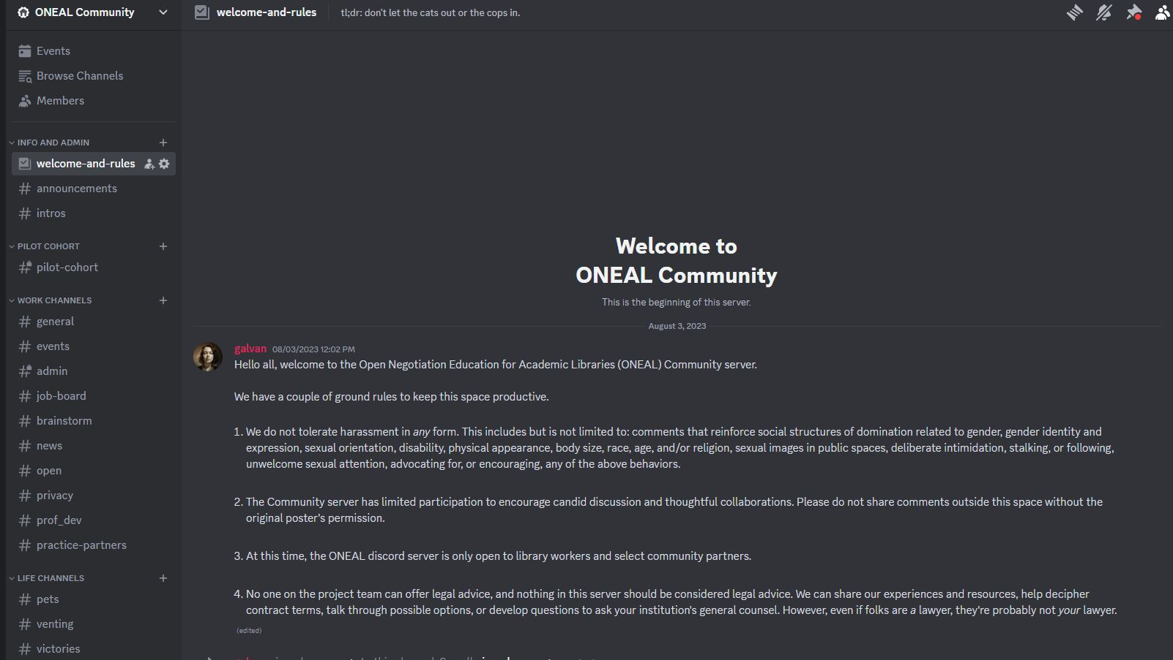
Join the community!
https://oneal-project.org/discord/
Notes:
In addition to the curriculum, and in support of it, we are also working to create a community. One of the things that we heard over and over when we were planning the curriculum and conducting the interviews was the need for a space for librarians who do this work to talk to one another. So we’ve started a Discord for the users of the curriculum, for them to use when they are working through the curriculum and have questions, comments, or need a partner. We are using Discord for this community and would like to invite you to join us! You can visit the URL on the screen to request access. If you’re not familiar with Discord, it’s a (mostly) text-based social platform. Individual communities are called Servers and have a collection of channels that allow work like individual chat rooms or message boards.
Please note that we are moderating this community, and it is only for current library workers. At some point there may be additional community opportunities for other groups.

Slide 20
Join the project!
Join our mailing list! We promise not to spam you – you’ll hear from us when new modules are launched or when we need help with something.
If you’re interested in contributing, we’re looking for people!
If you’d like to be a mock negotiator, we’d like to record some examples of how to use the case studies or how to put some of the techniques into action.
Visit our website https://oneal-project.org for details and ways to contact us.
Notes:
I’ll put a QR code up in just a minute that you can scan to join our mailing list. There’s a quick form to fill out, and we promise not to distribute your email address to anyone else nor spam you.
Contributing can take several different forms – if you’d like to help with one or more of the lessons in the Strategies or Issues modules, that would be awesome! You can also keep an eye out for a call for volunteers to do things like be a pilot tester. If you know someone who would be a good contact for lesson content, please let us know! You can also recommend a resource that you think we should know about and share with the community – your favorite book, website, video, etc. that’s helped you in your negotiations.
Another way to get involved would be to volunteer to be a mock negotiator. We’d like to record some examples of how to use the case studies or how to put some of the techniques into action.
Our website – oneal dash project dot org – has more details and ways to contact us. You can also request that one of us come and talk to your group about the ONEAL project – we’d love to share the word with more people!

Slide 21
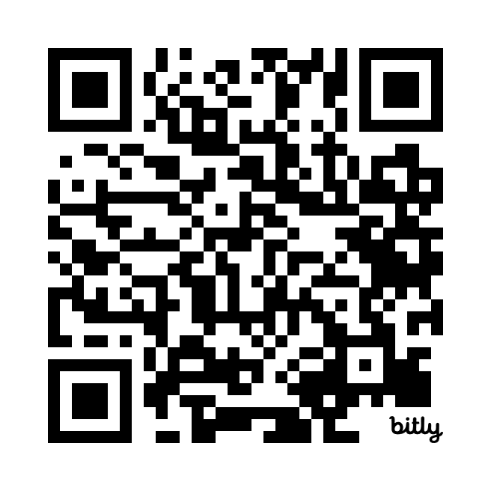
Join the mailing list!
Notes:
https://forms.gle/nw9bxqsxehxPTFoL8
https://bit.ly/ONEALmail

Slide 22
Thanks!
https://oneal-project.org
macyk@iu.edu
Notes:
The full slides will be available in Belmont’s Digital Repository, and I’m happy to share a link to that to put on the conference website. You can also email me to request the slides.

Slide 23
Interview Study
Notes:
As part of the ONEAL project we conducted an interview study to learn from a variety of academic library workers their overall experience with negotiations. We selected 40 people and ended up with 35 recorded semi-structured interviews that we were able to analyze.

Slide 24
Study Methods
Semi-structured interviews
Ensured diversity in background & institutions when selecting subjects
Data qualitatively coded using DEDOOSE software
Notes:
We sent out an invitation for people to apply to participate in the study and the project team carefully reviewed each candidate’s institutional and demographic background so we could ensure we included as many diverse voices as possible within this study. We then qualitatively coded the resulting interviews using Dedoose to find key themes. In addition to the preliminary results from the analysis we are about to share we are going to use the interviews to create more fictionalized case studies rooted in actual experiences of library workers to publish later in 2024.

Slide 25
Interview Questions
What do you find particularly challenging about negotiating for library resources?
Can you describe a time you experienced a difficult negotiation for a library resource?
Can you describe a time where a negotiation for a library resource went well for you?
Notes:
This included asking them to describe a negotiation that went well as well as one that was particularly difficult. We also asked about the challenges they faced when negotiating and their desired training and support.

Slide 26
Demographics
40 PEOPLE SELECTED, 35 COMPLETED INTERVIEWS
52% worked at private institutions / 48% public institutions
68% had 6 or more years of experience
17% respondents identified as BIPOC
More details on the demographics are in the Appendix at the end of this presentation
Notes:
Full demographics and additional information is available in the appendix of these slides, which will be available in Belmont’s Digital Repository, and I’m happy to share a link to that to put on the conference website.

Slide 27
Key Insights
Personal Challenges
Negotiation Challenges
Desired Training & Support
Notes:
We categorized things that our interviewees mentioned the most, and they fell into the following categories: personal challenges, negotiation challenges, and desired training and support. We’ll take a quick look at what some of those things were specifically.

Slide 28
Personal Challenges
Notes:
68.6% of interviewees mentioned some kind of personal challenge related to negotiations. The largest personal challenge was lack of experience or training for negotiations, followed closely by finding it difficult to say no especially considering the service profession expectations. As you might expect, anxiety about negotiations was also a challenge.

Slide 29
Negotiation Challenges
Notes:
97.1% of our interviewees commented on negative behaviors they had experienced when negotiating with the three largest issues being not understanding academic context, lack of responsiveness and sales representative lacks knowledge (in general – can be about the product, aspects of the license, or the institution). 25.7% mentioned that vendor turnover was a problem. I will add that 62.9% of subjects mentioned positive vendor behaviors including working to maintain the relationship, clear communication & transparency, and high responsiveness.
94.3% of those interviewed mentioned that they had experienced issues with internal stakeholders. The most frequent issues mentioned were around working with folks in the library and other faculty. 62.9% of participants who mentioned experiencing issues within their own library with the most frequently mentioned issues were colleagues not being on the same page, working proactively when approaching negotiations, and lateral decision making and creating agreement. 54.3% mentioned faculty issues with creating faculty buy-in being the largest specifically mentioned issue at 34.3%.
77% of participants mentioned business deal issues, with pricing being the most frequently mentioned issue being negotiated (66% of subjects mentioned). Other issues mentioned include the length of agreement, service problems, and payment terms.
57.1% of participants mentioned difficult licensing terms. The three license terms most mentioned were accessibility, NDAs or confidentiality, and Indemnity.

Slide 30
Desired Training & Support
Notes:
71.4% of participants mentioned some kind of training or support that they wanted to have. The most mentioned was licensing, but negotiation strategies were also one of the top types of training desired. The need for a community around negotiating and shared licensing language also came through from almost 20% of our participants. More on that in just a minute! ☺
Additional details from the interview study are available in the appendix to this presentation, which will be available in the Belmont Digital Repository.

Slide 31
Appendix
Additional results and demographics from the interview study

Slide 32
Negotiation Challenges
Notes:
The next few slides are a more in-depth breakdown of the various negotiation challenges that were mentioned by our interview subjects. 97.1% mentioned negative vendor behaviors. 94.3% mentioned internal stakeholder issues. 77% mentioned business deal issues, and 57.1% mentioned difficult licensing terms. The next few slides will show more of the specific topics that subjects struggled with in those areas.

Slide 33
Negative Vendor Behaviors
Notes:
97.1% of the interview subjects mentioned negative vendor behaviors. The most frequently mentioned issues in this category were a vendor’s lack of understanding of an academic context and a general lack of responsiveness from the vendors. Rounding out the top five issues were a lack of knowledge from the sales representatives, vendors not listening, timeline incongruence (vendors not responding in a timely manner), and a lack of trust in the vendor-library relationship.

Slide 34
Internal Stakeholder Issues
Notes:
94.3% of the interview participants mentioned internal stakeholder issues. Library and faculty issues where the most frequently mentioned, but buy-in across all stakeholders, administrative issues, and not understanding legal/ethical implications were also in the top five.
Library issues included things like: Colleagues not being on same page; Proactively approaching negotiations; Lateral decision making / Creating agreement with library professionals; Disconnect between resource and technical service needs; Flat / Eroding budget; Risk tolerance withing the library organization; Licensing negotiated after price; and Negotiation as organizational change
Faculty issues included things like: Faculty buy-in; Loud or complaining faculty; Need immediate access; Changed their minds after cancellation; and Reputation / Prestige
Administrative issues included things like: Administrative support; Building administrative buy-in; Losing administrative buy-in mid-process; Administration or departments bypassing library; and Accreditation processes
Procurement issues included things like: Lag time with Procurement and Procurement not understanding library licensing & resources
Legal issues included things like: Lag time with legal or general counsel; Difficult to get legal support; and Legal or general counsel not understanding library context

Slide 35
Business Deal Issues
Notes:
77% of those interviewed mentioned business deal issues. Unsurprisingly, pricing was the primary issue, but the length of agreement, service problems, and payment terms were also mentioned.

Slide 36
Difficult Licensing Terms
Notes:
57.1% mentioned difficult licensing terms. The licensing terms that most participants struggled with were accessibility, confidentiality (NDAs), and indemnity. Text data mining (TDM), privacy, and authorized users tied for the third most mentions.

Slide 37
Demographics
Notes:
The next few slides cover the specific demographics of the 35 participants who completed the interview study.

Slide 38
Private or Public Institution
Notes:
17 participants were from a private not-for-profit institution, while 16 were from public institutions.

Slide 39
Institutional Characteristics
Notes:
These designations are based on the Carnegie Classifications of the institutions that the participants were from. (See https://carnegieclassifications.acenet.edu/ for more details on the specific classifications and how they are determined). The majority of participants (19) came from doctorial universities with very high research activity. 4 participants came from doctoral universities with high research activities, and 5 came from Master’s Colleges & Universities (all sizes). We also interviewed 2 people who worked for consortia and 1 person who was at an Associate’s College: High Career & Technical High Traditional.

Slide 40
Degree of Urbanization
Notes:
The degree of urbanization classification is based on the IPEDS data on Campus Setting. For more information about how each classification is determined, please see https://nces.ed.gov/programs/edge/docs/locale_definitions.pdf. 12 participants were from large cities and 9 were from large suburbs. 3 were from remote towns and small cities, and only 1 was from a small suburb. The remaining 5 were from a midsize city.

Slide 41
Gender
Notes:
22 participants identified themselves as female and 9 identified as male. 2 identified themselves as non-binary or transgender, and 2 preferred not to answer.

Slide 42
Race/Ethnicity
Notes:
74% of interview participants (26) were white. 4 were Asian or Asian American, and 1 each were Hispanic, Latino, Latina, Latine/x or Middle Eastern or North African, White. Three participants preferred not to answer the question.

Slide 43
Experience
Notes:
The majority of interview participants had 6 or more years of experience (24). Only three had less than a year of experience, and three had between one and three years of experience. Five participants had between three and five years of experience.

